Slide 1
File handling in java
By Dhananjay Kumar B S

Slide 2
Contents
Definition
Purpose
Basic example
Streams
Java file class methods
File Operations in JAVA
Examples

Slide 3
File handling in JAVA
In Java, with the help of File Class, we can work with files. This File Class is inside the java.io package. The File class can be used by creating an object of the class and then specifying the name of the file.

Slide 4
Why file handling is required ?
File Handling is an integral part of any programming language as file handling enables us to store the output of any particular program in a file and allows us to perform certain operations on it.
In simple words, file handling means reading and writing data to a file.

Slide 5
Example
// Importing File Class
import java.io.File;
class GFG {
public static void main(String[] args)
{
// File name specified
File obj = new File("myfile.txt");
System.out.println("File Created!");
}
}

Slide 6
Streams in JAVA
In Java, a sequence of data is known as a stream.
This concept is used to perform I/O operations on a file.
There are two types of streams :
Input Stream and
Output Stream

Slide 7
Input Stream in JAVA
The Java InputStream class is the superclass of all input streams. The input stream is used to read data from numerous input devices like the keyboard, network, etc. InputStream is an abstract class, and because of this, it is not useful by itself. However, its subclasses are used to read data.
There are several subclasses of the InputStream class, which as follows:
AudioInputStream
ByteArrayInputStream
FileInputStream
FilterInputStream
StringBufferInputStream
ObjectInputStream

Slide 8
Declaration
// Creating an InputStream InputStream obj = new FileInputStream();

Slide 9
Methods of InputStream
S NO. | Method | Description
1 | read() | Reads one byte of data from the input stream.
2 | read(byte[] array) () | Reads byte from the stream and stores that byte in the specified array.
3 | mark() | It marks the position in the input stream until the data has been read.
4 | available() | Returns the number of bytes available in the input stream.
5 | markSupported() | It checks if the mark() method and the reset() method is supported in the stream.
6 | reset() | Returns the control to the point where the mark was set inside the stream.
7 | skips() | Skips and removes a particular number of bytes from the input stream.
8 | close() | Skips and removes a particular number of bytes from the input stream.

Slide 10
OutputStream in JAVA
The output stream is used to write data to numerous output devices like the monitor, file, etc. OutputStream is an abstract superclass that represents an output stream. OutputStream is an abstract class and because of this, it is not useful by itself. However, its subclasses are used to write data.
There are several subclasses of the OutputStream class which are as follows:
ByteArrayOutputStream
FileOutputStream
StringBufferOutputStream
ObjectOutputStream
DataOutputStream
PrintStream

Slide 11
Declaration
// Creating an OutputStream OutputStream obj = new FileOutputStream();

Slide 12
Methods of OutputStream
S No. | Method | Description
1 | write() | Writes the specified byte to the output stream.
2 | write(byte[] array) | Writes the bytes which are inside a specific array to the output stream.
3 | close() | Closes the output stream.
4 | flush() | Forces to write all the data present in an output stream to the destination.

Slide 13
Java File Class Methods
The following table depicts several File Class Methods:
Method Name | Description | Return Type
canRead() | It tests whether the file is readable or not. | Boolean
canWrite() | It tests whether the file is writable or not. | Boolean
createNewFile() | It creates an empty file. | Boolean
delete() | It deletes a file. | Boolean
exists() | It tests whether the file exists or not. | Boolean
length() | Returns the size of the file in bytes. | Long
getName() | Returns the name of the file. | String
list() | Returns an array of the files in the directory. | String[]
mkdir() | Creates a new directory. | Boolean
getAbsolutePath() | Returns the absolute pathname of the file. | String

Slide 14
File Operations in JAVA
The following are the several operations that can be performed on a file in java:
Create a File.
Read from a File.
Write to a File.
Delete a File.

Slide 15
1.Create a File
In order to create a file in Java, you can use the createNewFile() method.
If the file is successfully created, it will return a Boolean value true and false if the file already exists.

Slide 16
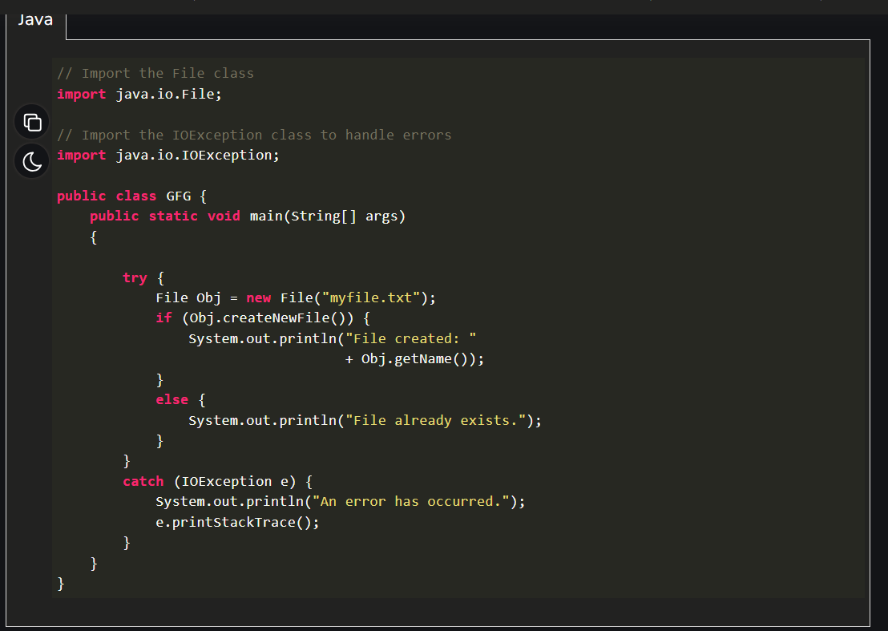
Program to demonstrate of how to create a file in JAVA:

Slide 17
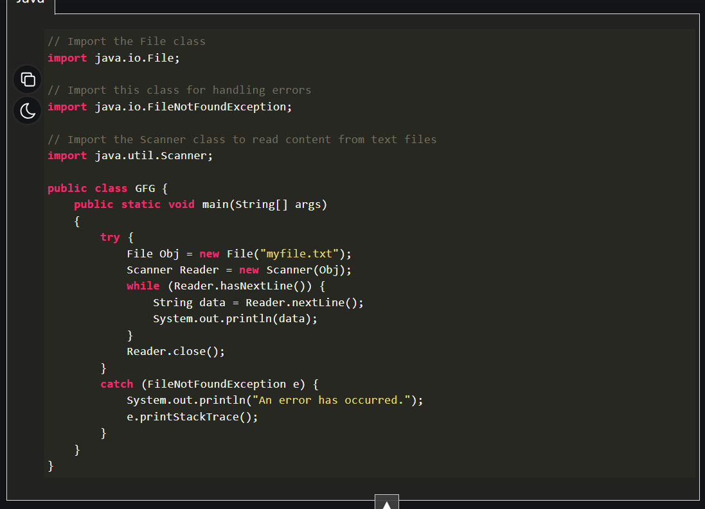
2.Read from a File
We will use the Scanner class in order to read contents from a file. Following is a demonstration of how to read contents from a file in Java :

Slide 18
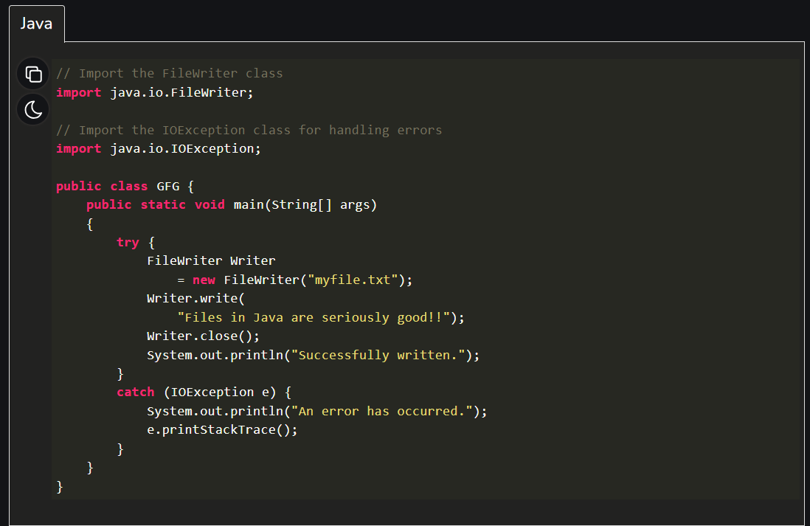
3.Write to a File
We use the FileWriter class along with its write() method in order to write some text to the file. Following is a demonstration of how to write text to a file in Java :

Slide 19
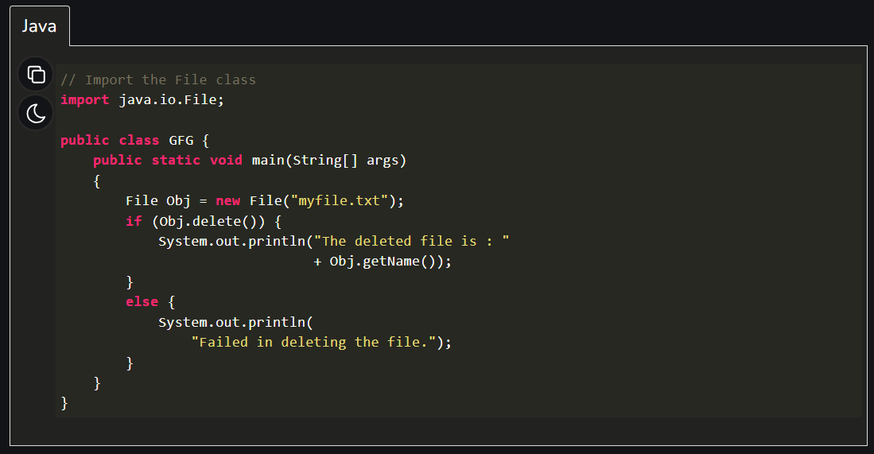
4.Delete a File
We use the delete() method in order to delete a file. Following is a demonstration of how to delete a file in Java :

Slide 20
Conclusion
file handling in Java is essential for managing file input/output operations, enabling reading, writing, and modifying data efficiently. With classes like File, FileReader, and FileWriter, Java simplifies handling files while ensuring data integrity and flexibility.

Slide 21
Thank you

